Slide 1


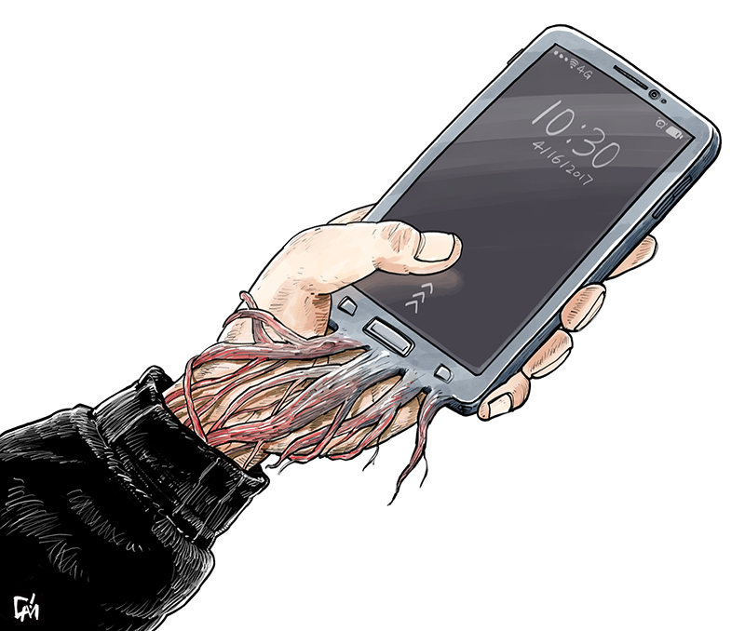
ICC24 | Bachelor Thesis Project-II
Using Machine Learning Algorithms for Prognosis of
Smartphone Addiction & Internet Gaming Disorder
Presented By
Mehak Malhotra 2018UIC3016
Mudit Mahajan 2018UIC3018
Raghav Kaushal 2018UIC3020
Shloka Gupta 2018UIC3150
Dept. of Instrumentation & Control Engineering
Netaji Subhas Institute of Technology (Under University of Delhi)
Notes:
Title
Problem Statement (Rise of internet gaming and negative effects of gaming)
Approach (app and ML)
App- Raghav
ML - Data, Algo, Results
Work Done until now
Proposed goals for end sem

Slide 2
Index
01
05
Problem Statements
Methodology
Motivation
02
06
Demo
Literature Review
03
07
Results & Conclusion
Proposed Solution
04
08
References

Slide 3
Features of Activity Tracker (Android App)
The application collects the data on daily basis from each participant. The data collected through the application is as follows:
Age: The age of participant was collected in years.
Gender: If the participant was a male or female.
Screen-on Duration: The total amount of time that has been spent on the smartphone each day with screen turned on.
Messages: The total amount of messages send and received by the users.
Call Duration : The total amount of duration of calls made by the user.
List of Applications: Day-wise list of applications that were used by the participant.
Usage Duration of Application: Day-wise usage duration of each application used by the participant.
Esteem Score: The self-esteem of a participant on a likert scale of 1-7.
Smartphone Addiction Questionnaire Score: A resultant score is computed through Smartphone Addiction Scale – Short Version (SAS – SV) for each participant.

Slide 4

Measures
1
Smartphone Addiction Scale – Short Version (SAS - SV)
Min Kwon et al. revised the smartphone addiction scale (SAS) and developed shorter version consisting of 10 items.
Response of each answer could vary from ‘Strongly Agree’ to ‘Strongly Disagree’, with a score of 1 to 6 associated with each response. The final result is obtained by adding up the score corresponding to each question.
The score of our participants ranges from 10 to 53.
The output feature to depict smartphone addiction is computed by using Smartphone Addiction Questionnaire Score and Gender as follows:
For males, the threshold value of score was 31, above which they were classified as addicted.
For females, the threshold value of score was 33, above which they were classified as addicted.
Single Item Self Esteem Scale
It is used to compute the self-esteem of a participant wherein they self-analyze and rate it on a Likert scale of 1 (‘very low’) - 7 (‘very high’) [48].
Table: Smartphone Addiction Model Output Labels
2

Slide 5
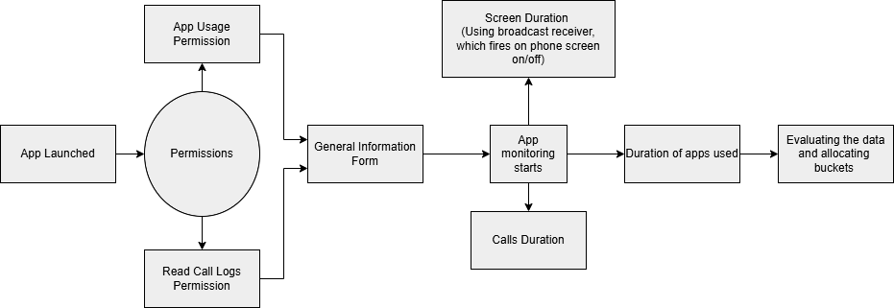
Architecture of the App

Slide 6
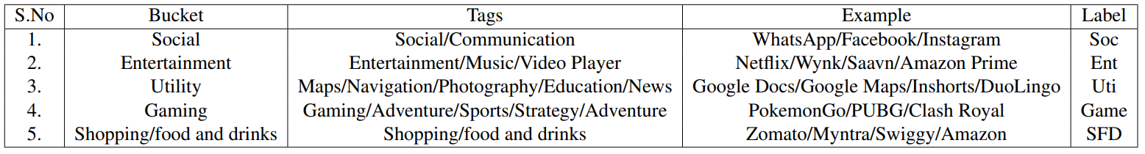
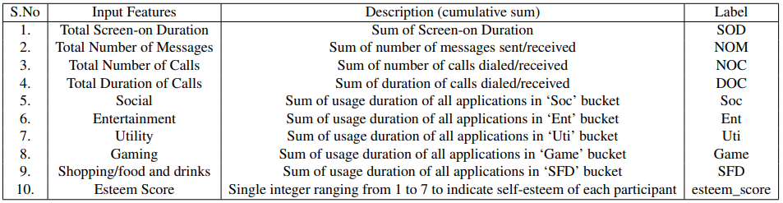
Dataset
Below are some sample rows of data collected by the app. The data has been collected from potential addicts being diagnosed at AIIMS Hospital and undergraduates at NSUT (N = 153)
Smartphone apps are categorised into 4 categories and 7-day average screen time for each category is calculated.
The data of these features is normalised and relevant features are selected.
Table: Description of buckets for each Android Application
Table: : Input Features to Smartphone Addiction Prediction ML Model

Slide 7

Application
Demo

Slide 8
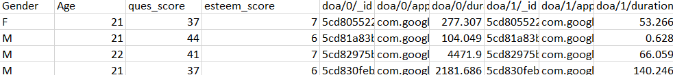
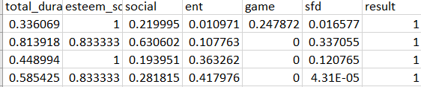
Dataset
Dataset Snippet (Before Pre-Processing)
Pre-Processed Data Snippet

Slide 9
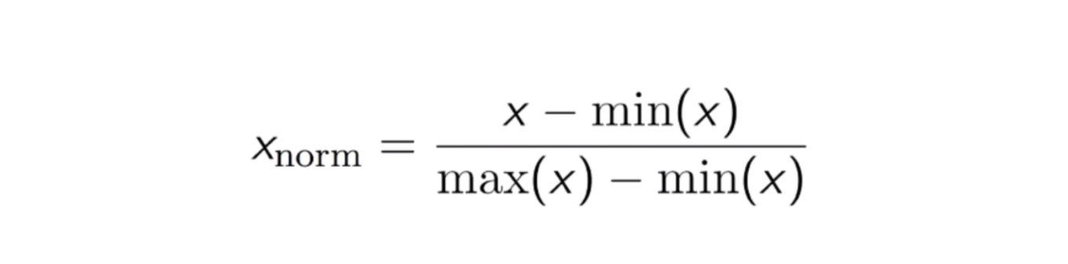
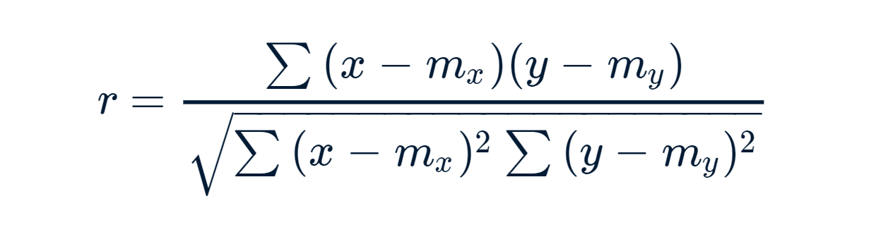
Concepts Used
For Pre-Processing of Data:
Normalization: It is a feature scaling technique. All the values are scaled down to lie between 0-1. In general for a feature min-max normalization follows:
For Calculating Correlation Between Input Features & Smartphone Addiction:
Pearson Correlation Coefficient: It is a linear correlation coefficient that returns a value of between -1 and +1. A -1 means there is a strong negative correlation and +1 means that there is a strong positive correlation. A 0 means that there is no correlation
where x: each data point of dependent variable; m_{x}: mean of all x
y: each data point of independent variable; m_{y}: mean of all y

Slide 10
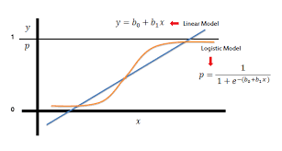
Learning Algorithms Used
The following four algorithms were used to predict smartphone addiction:
Logistic Regression: Logistic regression is a statistical model that uses a logistic function to model a binary dependent variable.
Linear Model: Calculate a linear function and then a threshold.
Logistic Model: It estimates the class probability directly.

Slide 11

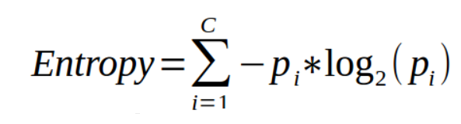
Learning Algorithms (contd.)
2) Decision Tree: Decision Trees are a type of Supervised Machine Learning (that is you explain what the input is and what the corresponding output is in the training data) where the data is continuously split according to a certain parameter.
In order to decide which feature to select in order to split the dataset, we calculate entropy of each feature . Higher the entropy, lesser the purity and higher the impurity.

Slide 12
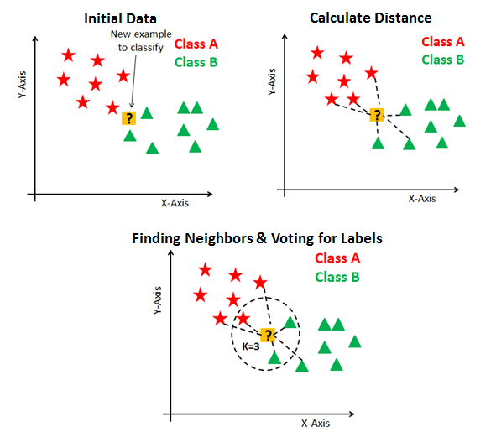
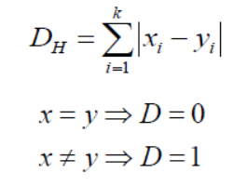
Learning Algorithms (contd.)
3) k-Nearest Neighbors: kNN tries to predict the correct class for the test data by calculating the distance between the test data and all the training points.
In kNN, algebraic distances are calculated but as soon as a categorical variable comes we calculate hamming distance. The dataset is standardized when we have a mix of numerical and categorical variables.
Hamming distance D_{H,}:

Slide 13
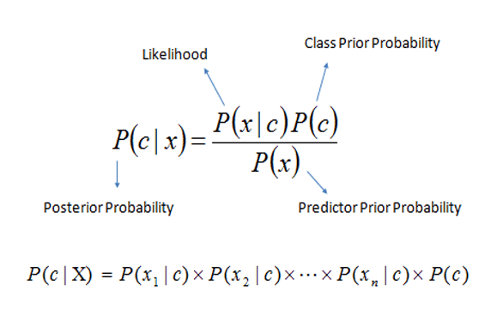
Learning Algorithms (contd.)
4) Naive Bayes: Supervised learning algorithms based on applying Bayes’ theorem with the “naive” assumption of conditional independence between every pair of features given the value of the class variable.

Slide 14
Conclusion and Results
The table shows results obtained when model was trained using different algorithms.
Algorithm | Accuracy(Test) | Accuracy(Train)
Logistic Regression | 57% | 72%
Decision Tree | 81% | 90%
KNN | 53.3% | 77%
Naive Bayes | 60% | 82.35%
=> Decision Tree provides best results with a maximum accuracy of 81% on the test data set and accuracy of 90% on training data set.

Slide 15
Conclusion and Results
Pearson’s Coefficients for different features
Feature | Pearson’s Coefficient
Total Screen-on Duration | 0.119
Social | 0.208
Entertainment | 0.012
Gaming | 0.180
Shopping & Food/Drinks | 0.201
Esteem Score | 0.169
As the total duration of screen time and shopping & food/drinks increases, the likelihood of the person to be addicted to smartphone also increases
The maximum effect can be seen through the usage of
Social applications with a positive correlation of 0.208

Slide 16
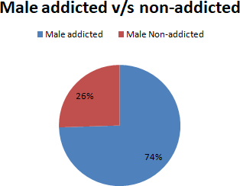
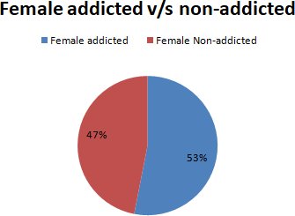
Gender Variation
The ratio of addicted to non addicted users was found to be higher in males than in females.

Slide 17
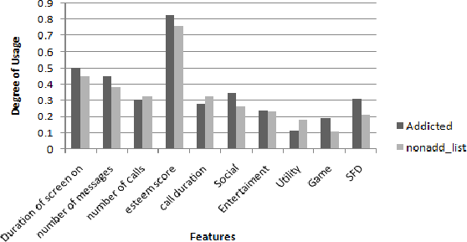
Distribution of Normalized Usage Factors
Social, Game and SFD have a higher degree of usage for addicted than non-addicted users.
Non-Addicted people have higher usage of utility apps.
Screen-on duration and number of messages is greater for addicted users.

Slide 18
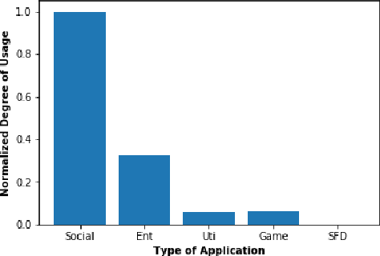
Comparison Between Usage of App Categories
The participants spend their maximum amount of time on Social applications, followed by applications related to entertainment and gaming and least amount of time in shopping and food and drinks

Slide 19
Conclusion and Results
The results show that information on users’ smartphone usage patterns can be used as predictors to determine whether users are addicted to smartphones. Existing questionnaires developed to determine smartphone addiction are mostly focused on the psychological factors of users. Because information on usage patterns provides more objective information, the results of this study can be used to improve existing surveys.
The results may serve as evidence of high complexity in the smartphone addiction diagnosis. In our model based on learning techniques, the user’s personal information and content usage patterns are required to ensure the sufficient accuracy. This means that various factors (age or content use) together influence the determination of smartphone addiction.
The results provide a basis for developing programs such as self-diagnostic applications to detect smartphone addiction. If we can diagnose the smartphone addiction level just from the information stored in a smartphone (without psychological factors), this can provide useful information to users through the form of applications or programs.
We hope that the study can provide directions for future work on the detection of smartphone addiction with inputs, which suggests that more detailed smartphone’s log-data will enable more accurate results.

Slide 20
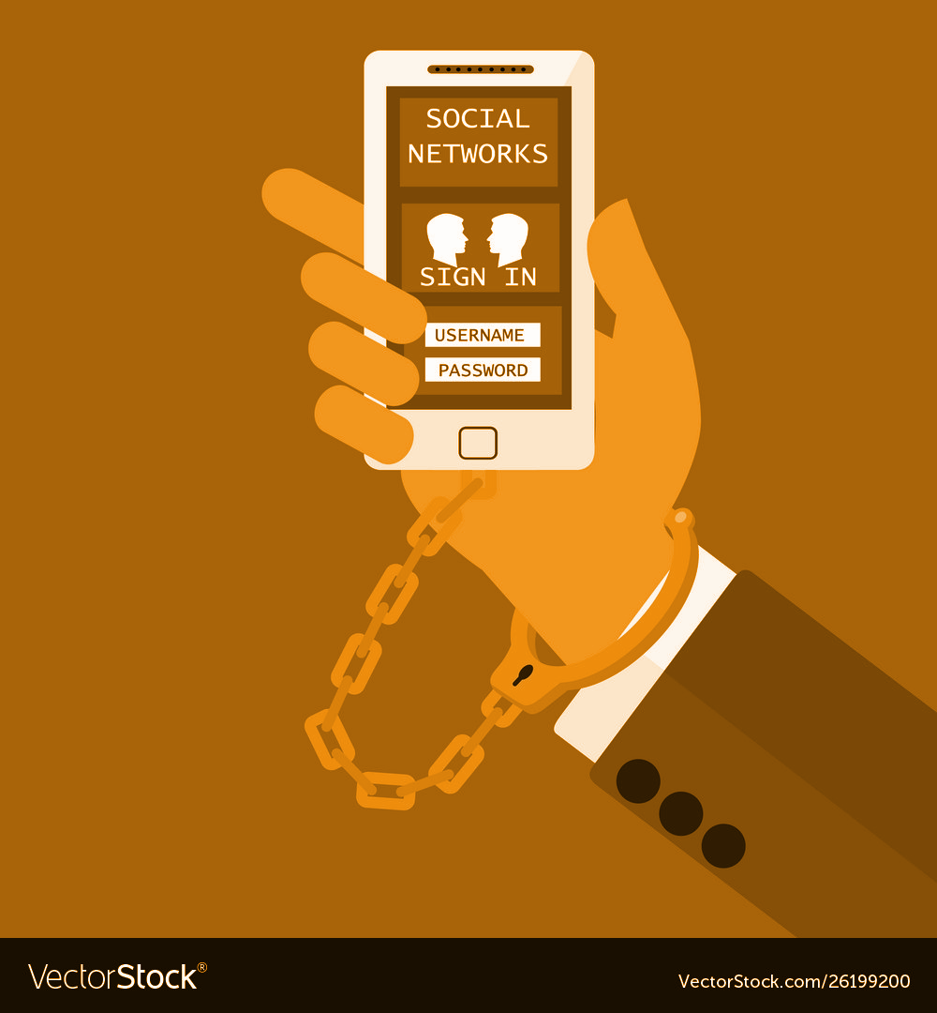
Problem Statement 2
To Predict likelihood of Psychological Disorders in Battlegrounds Mobile India (BGMI) players using Supervised Machine Learning Algorithms

Slide 21
Proposed Solution
We aim to analyze and use the game and player statistics of online gamers playing BATTLEGROUNDS MOBILE INDIA (BGMI - a MOBA game) in addition to self-measure of self-esteem of the gamers to predict whether they are suffering from Internet Gaming Addiction (IGD) and if they are likely to develop psychological disorders such as Generalized Anxiety Disorder (GAD) and ADHD using machine learning classification algorithms.

Slide 22
Methodology
Game and Player Statistics such as Daily kills, Daily wins, TotalGameTime of a player are extracted through the BGMI API. In case the gaming platform is Mobile, the screenshots of their game and player statistics are collected.
These In-game statistics along with self measure of self esteem are used as features to Supervised Machine Learning Classification Algorithms to predict IGD, ADHD and GAD.
We model our problem of detecting IGD, ADHD and GAD as three separate binary classification problems.
We consider and apply five stand alone supervised machine learning classifiers - Logistic Regression (LR), Naive Bayes (NB), Decision Tree (DT), Support Vector Machine and K - Nearest Neighbours.

Slide 23
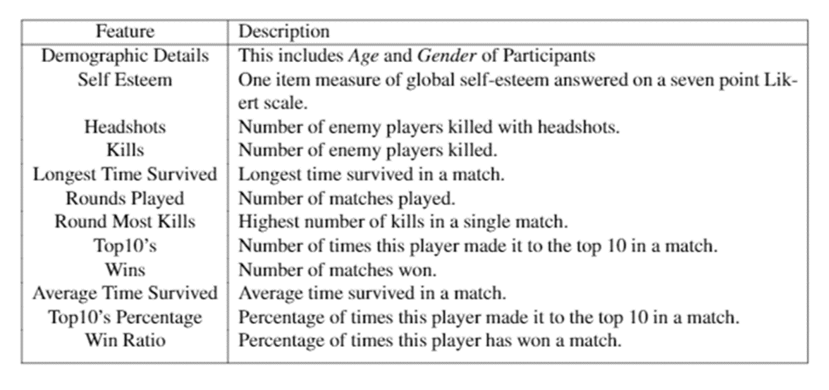
Features

Slide 24
Measures
1
Internet Gaming Disorder Scale - Short Form (IGDS9-SF)
The IGDS9-SF is a nine-item psychometric tool that measures the severity of Internet Gaming Disorder (IGD) as defined by DSM-5 (American Psychiatric Association, 2013).
A five-point Likert scale was used to answer all nine questions: 1 ('Never'), 2 ('Rarely'), 3 ('Sometimes'), 4 ('Often'), and 5 ('Very often'). The overall score is calculated by summing the participants' responses to the nine questions. The IGDS9-SF scores range from 9 to 45.
Adult ADHD Self-Report Scale
The ASRS-v1.1 is a six-item questionnaire that can be used to assess adults for ADHD. It is a subcategory of the 18-question WHO questionnaires symptoms checklist and is based on the American Psychiatric Association's (DSM-IV-TR).
"How frequently do you have trouble tying up the final touches of a job once the challenging sections have been completed?" and "How often do you have issues remembering appointments or obligations?" are two examples of inquiries.
The following alternatives were used to answer each of the six questions: 'Never’, ‘Rarely’, ‘Sometimes’, ‘Often’ and ‘Very Often’.
2

Slide 25
3
Generalized Anxiety Disorder (GAD-7)
The GAD-7 [46] is a seven-item anxiety scale that is used to screen for and measure the severity of Generalized Anxiety Disorder (GAD).
"Do you feel worried, apprehensive, or on edge?" and "Are you unable to stop or control worrying?" are examples of questions to which participants responded.
On a four-point Likert scale, 0 means "not at all," 1 means "a few days," 2 means "more than half the days," and 3 means "almost every day." By adding the answers to the questions, you can get the overall score. The GAD-7 scale runs from 0 to 21.
Single-Item Self-Esteem Value
The Single-Item Self-Esteem Scale[36] is a single-item self-esteem scale that can be used instead of the Rosenberg Self-Esteem Scale. Participants rate themselves on a seven-point Likert scale ranging from 1 to 7 ('Not very true of me').
4

Slide 26
Feature Selection
Gaming Related Features:
Aggregate of features
Features expressed as whole or real numbers denoting statistics such as number of rounds and kills were added from all three modes (Solo, Duo and Squad) to aggregate into a single feature.
E.g. Kills = Solo kills + Duo kills + Squad kills
Features in this category include Headshots, Kills, Rounds played, Wins and Top10s.
Mean of features
Features that are expressed as ratios or percentages like Top10% and Win Ratio, the average value from all three modes (single, duo and squad) is considered as a single feature.
E.g. Top10% = (Solo Top10% + Duo Top10% + Squad Top10%) / 3
Features in this category include Top10%, Win Ratio and Average Time Survived, Longest Time Survived and Round Most Kills. This combination of features creates 10 final game related input features.

Slide 27
Data Collection
The survey URL was shared on BGMI forums, as well as BGMI pages and groups on social media platforms including Facebook and Twitter. Due to the recent rise in popularity of BGMI mobile in India , BGMI tournaments are being held more frequently as part of gaming events and college fests, which have proven to be significant data providers.
S.no | Item | Description
1. | Demographic Details | This includes Age, Gender and Country of participants.
2. | BGMI Username | Unique BGMI Username of players is needed to extract their game
 |  | statistics.
3. | Platform Played On | Participants were asked if they played on XBOX, PS4, Mobile or PC.
 |  | Mobile users were further redirected to upload screenshots of their
 |  | statistics.
4. | IGDS9-SF | Nine items questionnaire to assess Internet Gaming Disorder
5. | ASRS-v1.1 | Attention Deficit HyperActivity Disorder (ADHD) is evaluated using
 |  | this six item tool.
6. | GAD-7 | An anxiety scale with 7 questions answered using 4 point Likert Scale.
7. | Self Esteem | One item measure of global self-esteem answered on a seven point Lik-
 |  | ert Scale

Slide 28
Demographic Features
Participants' age and gender are among the demographic characteristics. For convenience of calculation, both genders were given numerical labels: 1 for Male and 0 for Female.
Self-Esteem Score
The self esteem score obtained from the one-item measure of global self-esteem [36] is also used as a feature. Participants answer on a seven-point Likert scale ranging from 1 (‘Not very true of me’) to 7 (‘Very true of me’).
Table: Summary of features input to the Classification Algorithms
Feature | Description
Demographic Details Self Esteem Headshots Kills Longest Time Survived Rounds Played Round Most Kills Top10’s Wins Average Time Survived Top10’s Percentage Win Ratio | This includes Age and Gender of Participants One item measure of global self-esteem answered on a seven point Lik- ert scale. Number of enemy players killed with headshots. Number of enemy players killed. Longest time survived in a match. Number of matches played. Highest number of kills in a single match. Number of times this player made it to the top 10 in a match. Number of matches won. Average time survived in a match. Percentage of times this player made it to the top 10 in a match. Percentage of times this player has won a match.

Slide 29
Results and Discussion
1
Performance of different methods for binary classification
We were able to predict Internet Gaming Disorder and Generalized Anxiety Disorder with a maximum accuracy of 89% and 78% respectively using Logistic Regression (LR) classifier.
Decision tree classifier was most effective in predicting ADHD with an accuracy of 78%.
S.No | Model | IGD | ADHD | GAD
1. | Logistic Regression | 89.0% | 67.0% | 78.0%
2. | Naive Bayes | 88.0% | 44.4% | 77.8%
3. | Decision Tree | 77.8% | 78.0% | 66.6%
4. | K - Nearest Neighbors | 88.0% | 66.6% | 77.7%
5. | Decision Tree with Adaboost | 88.8% | 66.6% | 66.6%

Slide 30
Pearson Correlation between input features and various disorders
2
80% of the game and player statistics are positively correlated with IGD. This implies that larger values of Headshots, Kills etc are indicative of Internet Gaming Disorder.
S.No | Feature | IGD | ADHD | GAD
1. | Age | 0.18999 | -0.09624 | -0.15043
2. | Gender | 0.0422 | 0.07800 | 0.04222
3. | Self Esteem | -0.10728 | -0.06974 | -0.10132
4. | HeadShots | 0.27087 | 0.45662 | 0.25982
5. | Kills | 0.34077 | 0.39817 | 0.30601
6. | Longest Time Survived | 0.15571 | 0.34541 | 0.16738
7. | Rounds Played | 0.30362 | 0.49618 | 0.11738
8. | Rounds Most Kills | 0.30948 | 0.28266 | 0.27594
9. | Top10’s | 0.37222 | 0.21624 | 0.26175
10. | Wins | 0.48817 | 0.116552 | 0.24547
11. | Average Time Survived | -0.00212 | 0.10940 | 0.19868
12. | Top10’s% | -0.01044 | -0.04794 | 0.15568
13. | Win Ratio | 0.07603 | -0.07329 | 0.14545

Slide 31
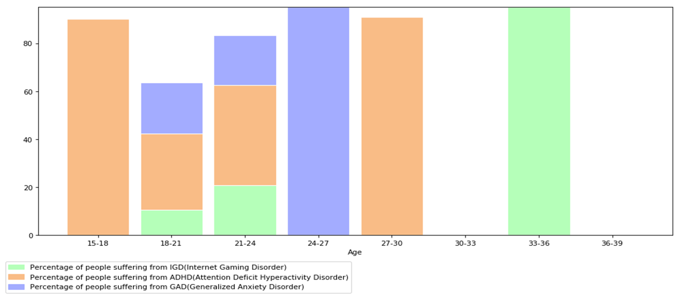
Percentage of people suffering from various disorders for different age groups
3

Slide 32
Conclusion
We were able to predict the presence of IGD, ADHD, and GAD with considerable accuracy.
This was the first study that used Supervised Machine Learning Algorithms to predict IGD, GAD and ADHD using game and player statistics of an online MOBA game (BGMI).

Slide 33
Appendix A
Chapter A
Smartphone Addiction Survey in Android Application
The survey was a part of the android application circulated amongst the participants and collected the demographic information of each participant and required them to fill certain measures. The survey had the following items:
A.1 Demographic Details
1. Age
2. Gender
3. Name
A.2 Questionnaire 1 (Smartphone Addiction Scale–Short Version)
1. I miss planned work due to smartphone use
2. I have a hard time concentrating in class, while doing assignments, or while working due to smartphone use
3. I feel pain in the wrists or at the back of the neck while using a smartphone
4. I won’t be able to stand not having a smartphone
5. I feel impatient and fretful when I am not holding my smartphone
6. I have my smartphone in my mind even when I am not using it
7. I will never give up using my smartphone even when my daily life is already greatly affected by it
8. I constantly checking my smartphone so as not to miss conversations between other people on Twitter or Facebook
9. I use my smartphone longer than I had intended
10. The people around me tell me that I use my smartphone too much
A.3 Questionnaire 2 (Single-Item Self-Esteem Scale)
1. Do you have high self-esteem?

Slide 34
Further Improvements
Each app was placed into one of a few buckets in the study to predict smartphone addiction. As a result, this categorization can be reduced down into more buckets, giving our models additional input features, and future work can focus on training supervised models with a larger number of features.
Since the number of participants in the study to predict IGD, ADHD, and GAD was small, the study can be expanded to include a larger number of people who can be compared to a variety of different traits.

Slide 35
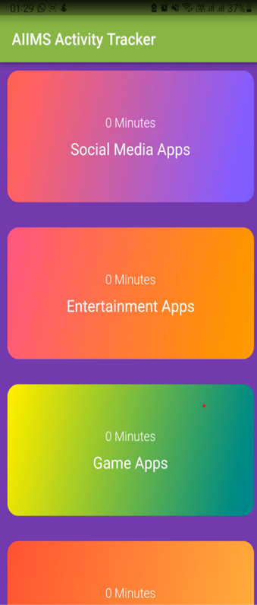
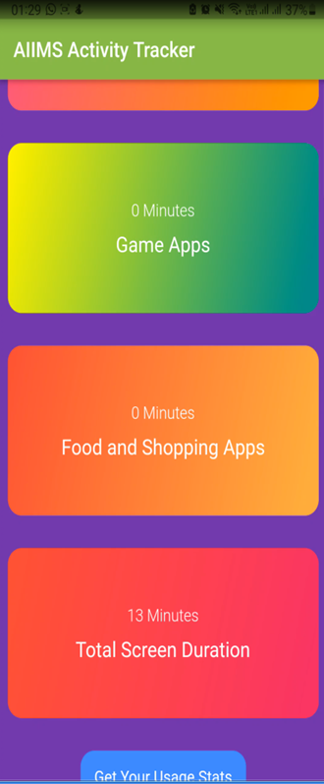
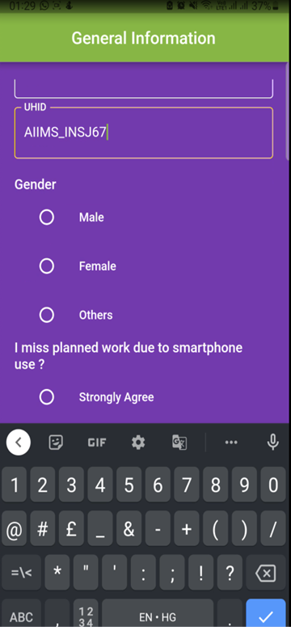
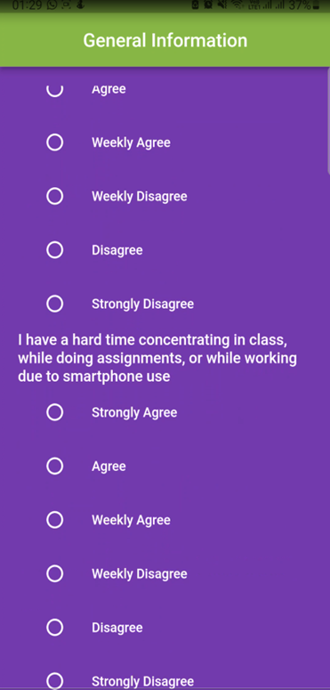
Appendix A
Chapter B
Screenshots Of Smartphone Data Collection Android Application (Activity Tracker)

Slide 36
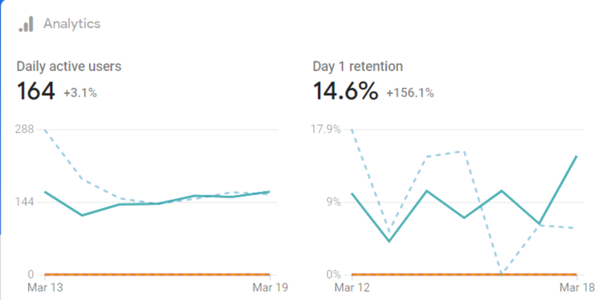

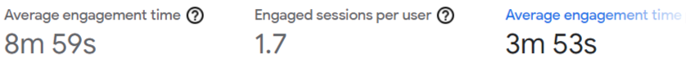
Appendix A
Chapter C: App Usage Statistics

Slide 37
Appendix B
Chapter A
Psychological Disorder Survey Circulated
The circulated online survey collected the demographic information of participants and required them to fill certain measures. The survey was composed of the following items:
A.1 Demographic Details
1. Age
2. Gender
3. BGMI Username
4. Gaming Platform for BGMI
A.2 Questionnaire 1 (Internet Gaming Disorder Scale–Short-Form)
1. Do you feel preoccupied with your gaming behavior?
2. Do you feel more irritability, anxiety or even sadness when you try to either reduce or stop your gaming activity?
3. Do you feel the need to spend an increasing amount of time engaged in gaming in order to achieve satisfaction or pleasure?
4. Do you systematically fail when trying to control or cease your gaming activity?
5. Have you lost interest in previous hobbies and other entertainment activities as a result of your engagement with the game?
6. Have you continued your gaming activity despite knowing it was causing problems between you and other people?
7. Have you deceived any of your family members, therapists or others because the amount of your gaming activity?
8. Do you play in order to temporarily escape or relieve a negative mood (e.g., helplessness, guilt, anxiety)?
9. Have you jeopardized or lost an important relationship, job or an educational or career opportunity because of your gaming activity?

Slide 38
Appendix B
A.3 Questionnaire 2 (Adult ADHD Self-Report Scale)
1. How often do you have trouble wrapping up the final details of a project, once the challenging parts have been done?
2. How often do you have difficulty getting things in order when you have to do a task that requires organization?
3. How often do you have problems remembering appointments or obligations?
4. When you have a task that requires a lot of thought, how often do you avoid or delay getting started?
5. How often do you fidget or squirm with your hands or feet when you have to sit down for a long time?
6. How often do you feel overly active and compelled to do things, like you were driven by a motor?
A.4 Questionnaire 3 (Generalized Anxiety Disorder)
1. Do you feel nervous, anxious or on edge?
2. Are you not able to stop or control worrying?
3. Do you worry too much about different things?
4. Do you have trouble relaxing?
5. Do you ever feel so restless that it is hard to sit still?
6. Do you become easily annoyed or irritable?
7. Do you feel afraid as if something awful might happen?
A.5 Questionnaire 4 (Single-Item Self-Esteem Scale)
1. Do you have high self-esteem?

Slide 39
References
[1] Psych Guide, An american addiction resource centers, “Video Game Addiction Symptoms, Causes and Effects”, An american addiction resource centers, [online document], Available: https://www.psychguides.com/behavioral-disorders/video-game-addiction/, 2022
[2] Indo Asian News Service, “India to have 800 million smartphone users by 2022: Cisco Study”, 03 Dec 2018. Available:https://tech.hindustantimes.com/tech/news/india-to-have-over-800-million-smartphone-users-by-2022-cisco-study-story-nnYnDOiY6nulyiKRaZRsDP.html
[3] Sandhya Keelery, “Internet Usage in India - Statistics & Facts”, Aug, 2021. Available: https://www.statista.com/topics/2157/internet-usage-in-india/:
[4] K. S. Young, “Internet addiction: The emergence of a new clinical disorder”, Cyberpsychology & behavior, vol. 1, no. 3, pp. 237–244, 1998.
[5] Y. Zhang, S. Mei, L. Li, J. Chai, J. Li, and H. Du, “The relationship between impulsivity and internet addiction in chinese college students: A moderated mediation analysis of meaning in life and self-esteem”, PLoS One, vol. 10, no. 7, e0131597, 2015.
[6] Y.-L. Chen and S. S.-F. Gau, “Sleep problems and internet addiction among children and adolescents: A longitudinal study”, Journal of sleep research, vol. 25, no. 4, pp. 458–465, 2016.
[7] N. A. Shapira, T. D. Goldsmith, P. E. Keck Jr, U. M. Khosla, and S. L. McElroy, “Psychiatric features of individuals with problematic internet use”, Journal of affective disorders, vol. 57, no. 1-3, pp. 267–272, 2000.
[8] M. D Griffiths, D. J Kuss, and D. L King, “Video game addiction: Past, present and future”, Current Psychiatry Reviews, vol. 8, no. 4, pp. 308–318, 2012

Slide 40
Thank you!
Would love to answer your questions
Mehak Malhotra 2018UIC3016
Raghav Kaushal 2018UIC3020
Mudit Mahajan 2018UIC3018
Shloka Gupta 2018UIC3150

Slide 41
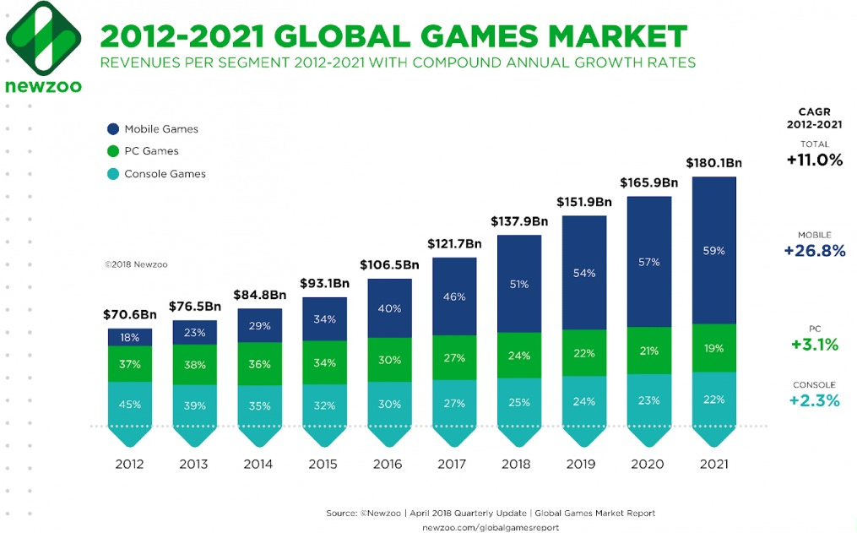
Motivation
In spring 2020, gaming quickly emerged as one of the most popular activities during the initial outbreak of the global COVID-19 pandemic as user engagement and spending surged between February and April of that year. Especially younger generations Gen Z and Millennials spent more time on gaming as the medium was a convenient way to spend time during initial stay at home orders, lockdowns, and social distancing.

Slide 42
Project Roadmap
2
Collection of more data
Data collection through various events to be conducted by the gaming society of NSUT, Venatus, during Moksha would be immensely helpful in improving accuracy of prediction of the models.
3
Improvements in the Android application (Activity Tracker)
Make the app more user friendly
Optimise the data collection and give the user recommendation on how to lower his/her addiction

Slide 43
Project Roadmap
Implementing Supervised Machine Learning Algorithms to Predict likelihood of Psychological Disorders in Battlegrounds Mobile India (BGMI) players
This would comprise of predicting the likelihood of a player to suffer from
Internet Gaming Disorder (IGD)
Attention Deficit Hyperactivity Disorder (ADHD)
Generalized Anxiety Disorder (GAD) using supervised machine learning algorithms
The models would take gaming statistics of BGMI players along with their demographic details and self reported self-esteem measure to make predictions
1

